Slide 1
Daniel Tilley C14337041 DT228 - 4
Training Pal
Interim Presentation
4th December

Slide 2
Introduction
What is Training Pal?
Where did the idea come from?
Who is it targeted at?

Slide 3
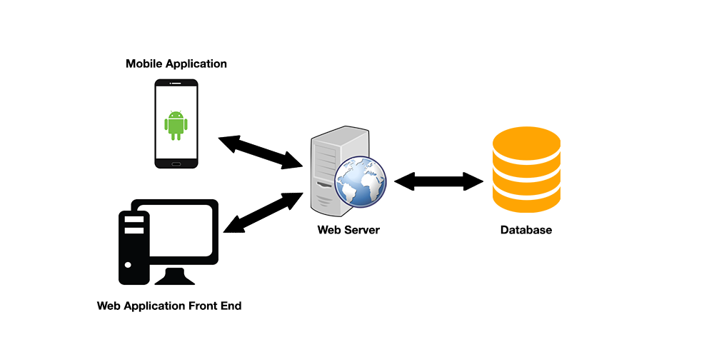
Brief Overview

Slide 4
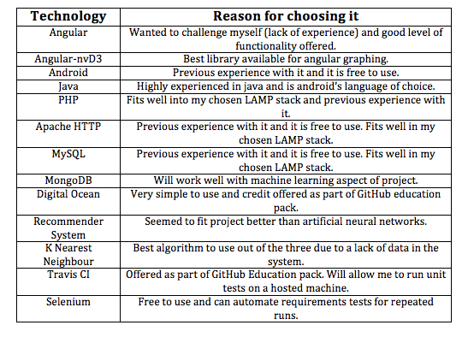
Chosen Technologies

Slide 5
Key Features
Athlete / Coach User Profiles
Training Logs and Goals
Events
User to User Interaction
System Recommendations

Slide 6
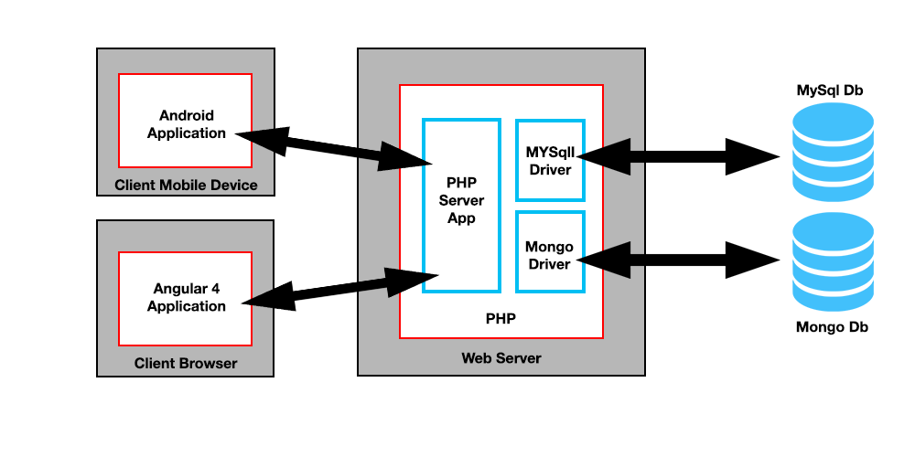
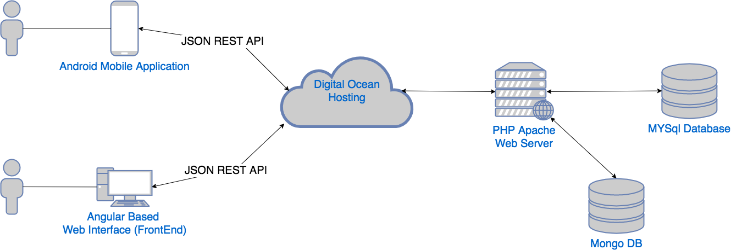
Technical Architecture

Slide 7
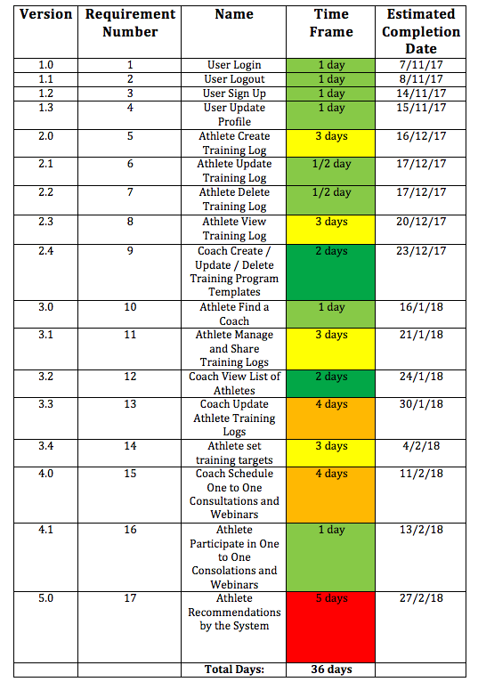
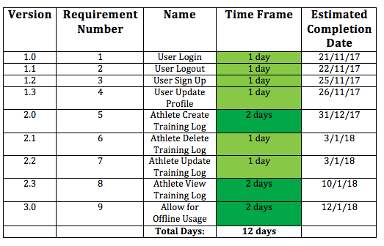
Versions and Methodology

Slide 8
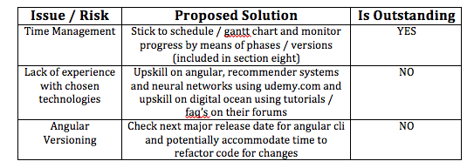
Risk Management and Mitigation

Slide 9
Evaluation Criteria
Unit Testing
System Testing
Versioning and Time Management

Slide 10
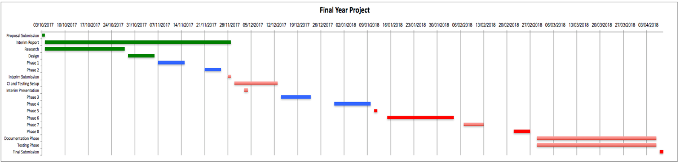
Future Work

Slide 11
Demo

Slide 12
Conclusion
Any Questions???

